Slide 1
Cryptocurrency Price
Direction Prediction
27 GB
Dataset
2.75M
on the Binance Full History Dataset
Using Classical Machine Learning Algorithms
1-min candles
5 yrs
PRODAN CONSTANTIN-IUSTIN
Dept. of Computers and Information Technology
University of Craiova, Romania
Metodologia Cercetării Științifice în Informatică — 2026
2017–2022
AUC 0.547
Best result

Slide 2
Presentation Outline
01
Problem Formulation
05
Key Feature Distributions
What are we predicting? Target variable definition & numerical example
Train vs. test distributional alignment
02
Dataset & Train-Test Split
06
Models & Experimental Setup
27 GB Binance data — strict chronological 80/20 split
Logistic Regression · Random Forest · Gradient Boosting
03
Feature Engineering
07
Results
18 technical indicators derived from OHLCV (SMA, EMA, MACD, RSI, BB…)
ROC curves · Confusion Matrix · Feature Importance
04
Class Label Distribution
08
Comparison & Conclusions
Near-balanced classes — no trivial baseline exists
State-of-the-art context and future directions

Slide 3
Problem Formulation
Asset: BTC/USDT · Horizon: 1 hour · Task: Binary classification
Target Variable yₜ
Machine Learning Task
yₜ = 1 if close_{t+1} > close_t (price ↑)
yₜ = 0 otherwise (price ↓ or flat)
Input
xₜ ∈ ℝ¹⁸ — 18 technical indicators at hour t
Output
f(xₜ) ∈ {0, 1} — price direction at hour t+1
Numerical Example:
No leakage
Only data at close of bar t is used
close₁₀₀ = $29,500 → close₁₀₁ = $29,750 ⟹ y₁₀₀ = 1
close₁₀₁ = $29,750 → close₁₀₂ = $29,600 ⟹ y₁₀₁ = 0
Balanced
51.3% Class 1 (train) | 49.5% (test)
Metrics
ROC-AUC + Accuracy on held-out test set
"Can 18 OHLCV-derived technical indicators predict, at above-chance rate,
whether the next hourly BTC/USDT closing price will be higher or lower?"

Slide 4
Dataset & Train-Test Split
Dataset Summary
Chronological 80 / 20 Split
Trading pair
BTC/USDT (Binance)
TRAINING 80%
TEST
20%
36,585 obs. | Aug 2017 — Mar 2022
Raw granularity
1 minute (OHLCV)
After resample
1 hour → 45,732 obs.
Training Set
Test Set
36,585 obs.
9,147 obs.
Date range
Aug 17, 2017 — Nov 16, 2022
Aug 2017 – Mar 2022
Apr 2022 – Nov 2022
Missing values
0 (complete dataset)
Class 1: 51.3% | Class 0: 48.7%
Class 1: 49.5% | Class 0: 50.5%
Price range
$2,817 — $69,000
No future data in training
Declining market — harder regime
Coeff. of variation
86.76% (extreme volatility)
Key principle: NO SHUFFLING applied. Scaler is fitted on training data only.
This prevents any information from the test period from contaminating model training.

Slide 5
Feature Engineering — 18 Technical Indicators
Trend
(Moving Avg.)
Momentum
Volatility
SMA_7
MACD
BB_width
SMA_25
MACD_signal
volatility
SMA_99
MACD_hist
EMA_12
RSI
EMA_26
Returns
Candlestick
Shape
Volume
return_1
body
volume
return_24
upper_wick
return_168
lower_wick
All features use only data available at bar-close time t — no future information enters any computation.

Slide 6
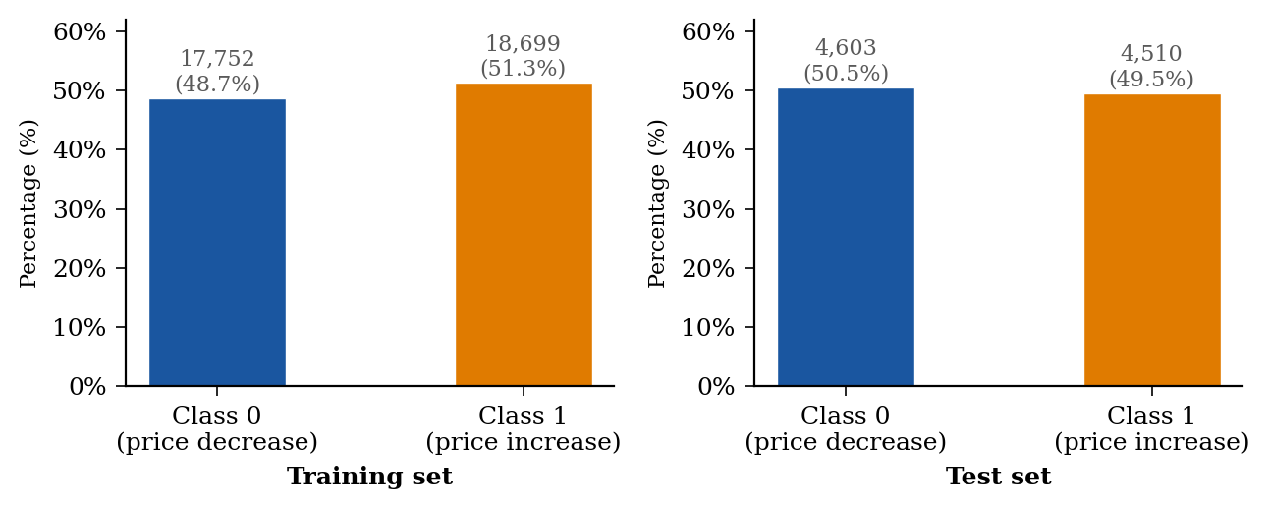
Class Label Distribution
Near-balanced classes — no trivial majority-class baseline
Both sets near-balanced
51.3% Class 1 in training vs 49.5% in test — no strong directional bias in either period
No oversampling applied
Class weights are equal; accuracy is a valid metric alongside ROC-AUC
Slight shift train→test
50.5% Class 0 in test (Apr–Nov 2022) reflects the declining bear-market phase

Slide 7
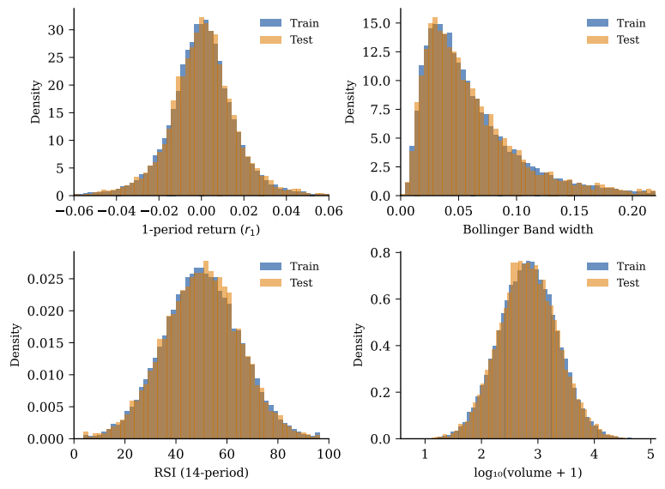
Key Feature Distributions — Train vs. Test
Minimal distributional shift confirms temporal split is representative
Panel Descriptions:
return_1 (top-left)
Fat tails (leptokurtic): most returns near zero, rare large moves. Gaussian assumption would underfit.
BB_width (top-right)
Right-skewed: alternates between low-volatility calm periods and high-volatility spikes.
RSI (bottom-left)
Bell-shaped near 50: neither overbought nor oversold conditions dominate the sample.
log(volume) (bot-right)
Log-normal; train and test nearly identical — trading activity stable across both periods.

Slide 8
Models & Experimental Setup
LR
RF
GB
Logistic Regression
Random Forest
Gradient Boosting
max_iter = 1000
n_estimators = 100
n_estimators = 100
C = 1.0 (L2 regularization)
max_features = sqrt(18) ≈ 4
learning_rate = 0.1
solver = lbfgs
random_state = 42
max_depth = 3 | random_state = 42
Linear baseline. Fits sigmoid to 18 standardized features. Interpretable via coefficients.
Bagging ensemble of 100 decision trees. Provides feature importance via mean impurity decrease.
Sequential boosting on log-loss. Best at capturing weak additive signals in high-noise data.
All models: scikit-learn · trained on 36,585 obs. · evaluated on 9,147 obs. · no hyperparameter tuning on test data

Slide 9
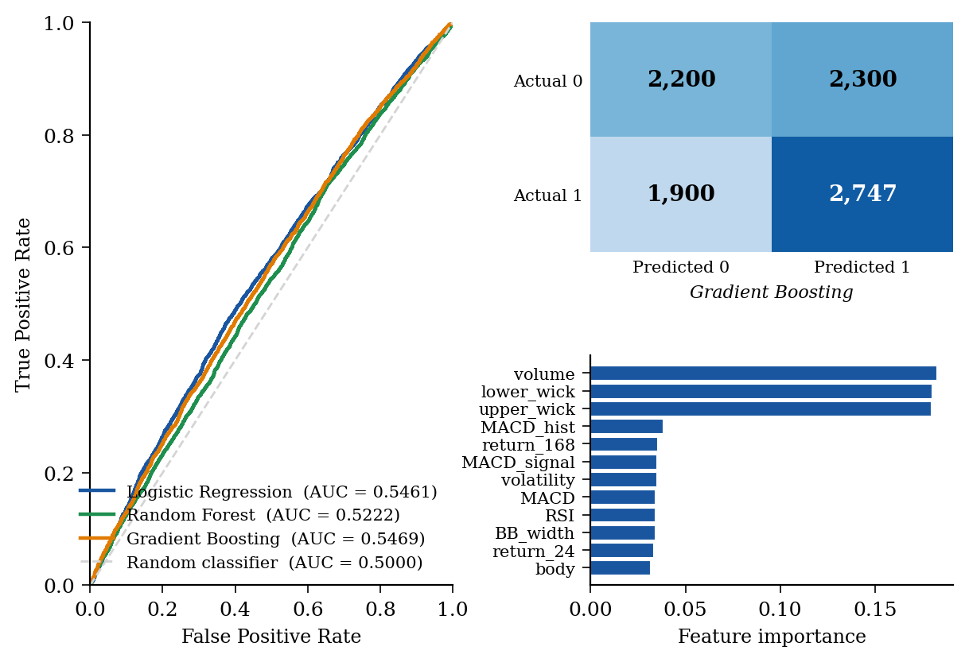
Results: ROC Curves · Confusion Matrix · Feature Importance
Performance:
Model Acc AUC
Logistic Reg.
Acc=0.5337 AUC=0.5461
Random Forest
Acc=0.5133 AUC=0.5222
Grad. Boosting
Acc=0.5345 AUC=0.5469
Baseline (rnd)
Acc=0.5000 AUC=0.5000
Key Insights:
GB ≈ LR
Feature relationships are largely linear
RF lags
Bagging less effective on high-noise data
CM asymmetry
Model biased toward Class 1 (up moves)
Top features
volume · lower_wick · upper_wick

Slide 10
Comparison with State-of-the-Art
Study
Model
Best Result
Task
Dataset
This work
Gradient Boosting
AUC = 0.547
Classification
Binance Full History
Jaquart et al. 2021
XGBoost + all feats
Acc = 55.6%
Classification
Multi-source
Livieris et al. 2023
Bi-LSTM
RMSE (lowest)
Regression
BTC / ETH / LTC
Chen 2023
LSTM
RMSE = 0.0054
Regression
BTC/USDT
Manikumar et al. 2023
RF + CatBoost
RMSE = 365 USD
Regression
Binance 2017–2022
Turganaliev 2024
LSTM
MAPE (low)
Regression
Binance multi-TF
Gap vs. Jaquart et al. explained by features, NOT models: their OHLCV-only ablation reaches ~52-53% — consistent with our 53.4%.
The remaining gap comes from sentiment + on-chain + macro features. Exogenous data enrichment is the key lever.

Slide 11
Conclusions & Future Work
Main Findings:
Future Directions:
1
Gradient Boosting is best
Integrate Twitter/Reddit sentiment
AUC = 0.5469 > Logistic Regression (0.5461) > Random Forest (0.5222) > random baseline (0.5000)
2
Weak but real signal
Add on-chain blockchain metrics
All models beat chance — consistent with semi-strong market efficiency (EMH)
Implement LSTM / Transformer
3
Largely linear relationships
GB ≈ LR gap confirms OHLCV features relate linearly to the direction target
Walk-forward validation
4
Volume + wick features dominate
Intra-bar price dynamics carry more directional info than moving averages
SHAP explainability analysis
5
Exogenous data is the key lever
OHLCV-only ceiling ~53%; enriched models (sentiment, on-chain) reach ~55-56%
Extend to all 500+ trading pairs
Thank you for your attention! | Questions?

